Slide 2
katalon Studio Tutorial

Slide 3
Content
Test Project
Test Object
Test Case
Test Suite
Test Data
Custom Keyword
Source Control – SVN
Console Mode Run
qTest Integration
Web Service Test
katalon studio tutorial

Slide 4
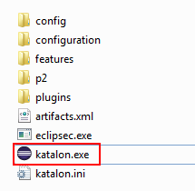
Start katalon Studio
Double click on katalon.exe icon to start Katalon Studio
katalon studio tutorial

Slide 5
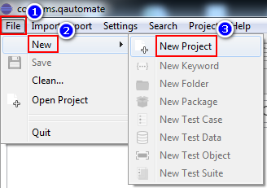
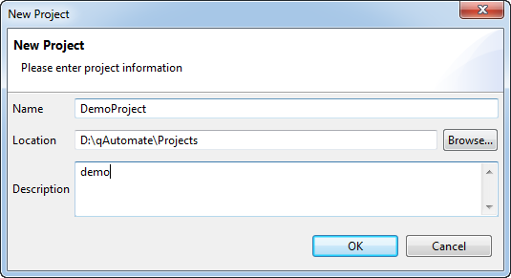
Create test project
From Menu bar > File > New > New Project
Enter project name, location (mandatory) and description (optional). Click OK to create a new project.
katalon studio tutorial

Slide 6
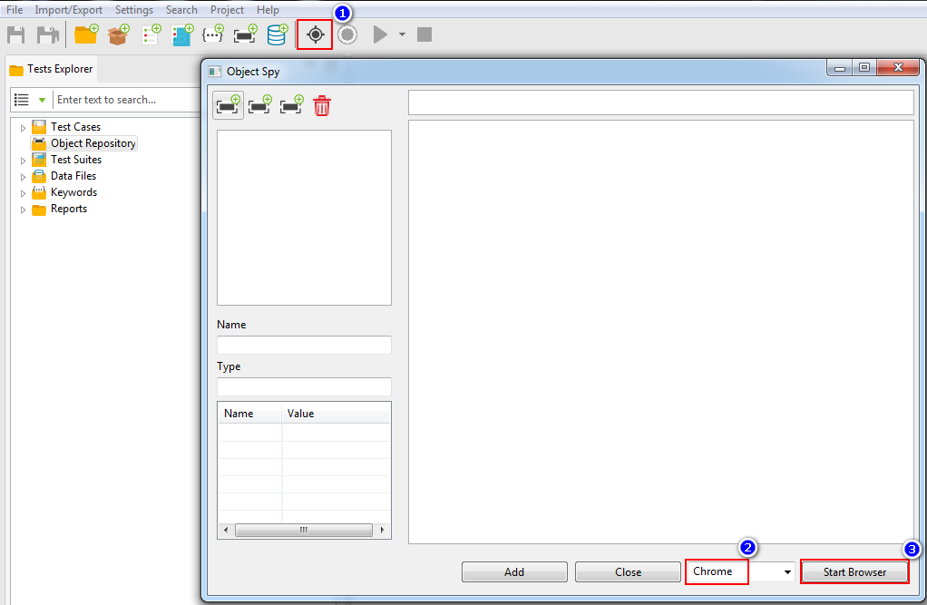
Detect test object
Click Spy icon
Click Start Browser to start spying object
Select browser
katalon studio tutorial

Slide 7

Detect test object
Navigate browser to the web site under test
Hover mouse over the web element, press Alt ~ to capture it
To load current state of the website to Object Spy, press Ctrl Alt ~
katalon studio tutorial

Slide 8
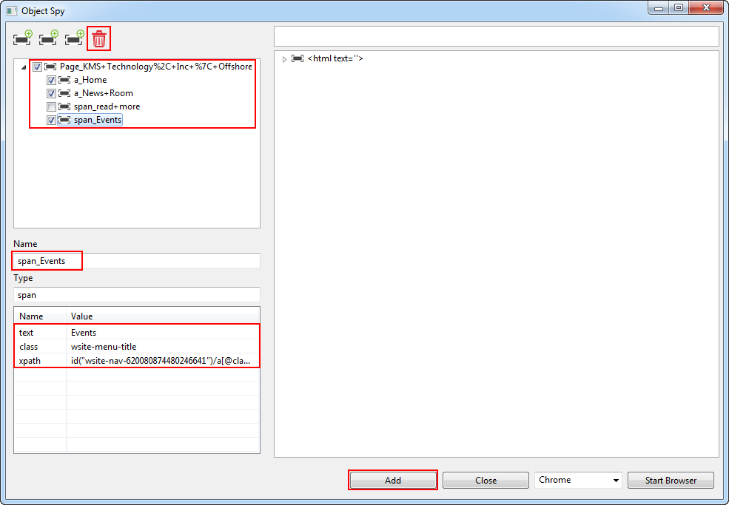
Detect test object
Click to delete object
After capturing objects, check those objects you want to keep
Users can rename or edit property value
Click Add button to add them into Object Repository
katalon studio tutorial

Slide 9
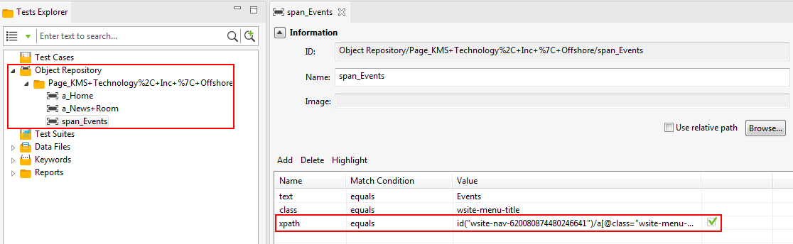
Detect test object
Checked properties will be used to uniquely identify the elements
Objects will be added into Object Repository
katalon studio tutorial

Slide 10
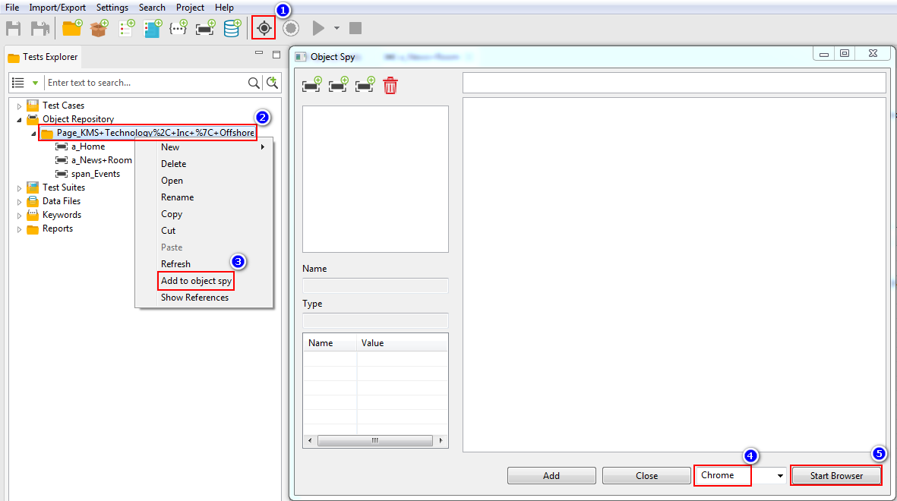
Verify test object changed
Open Object Spy
Right click on folder or test object
Add test object into Object Spy
Start Browser and navigate to site where objects reside
Select browser
katalon studio tutorial

Slide 11
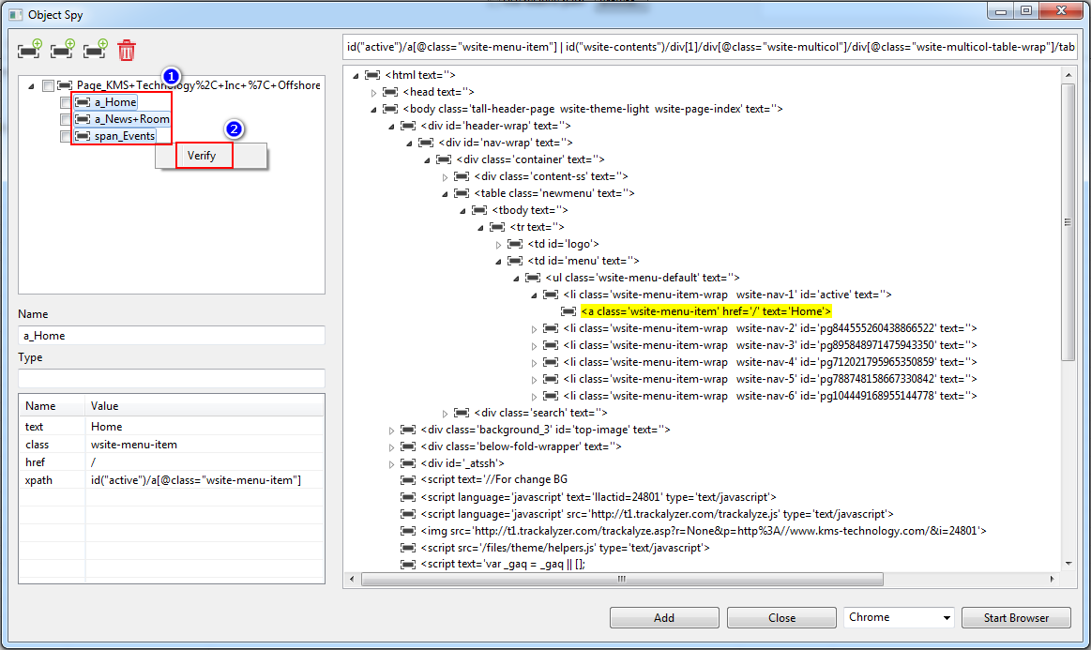
Verify test object changed
Highlight objects, right click
Click to verify changes
katalon studio tutorial

Slide 12
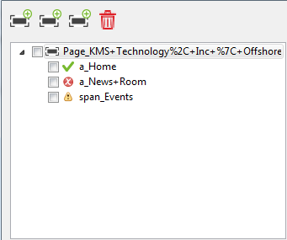
Verify test object changed
Object found. Nothing changed
Object not found
Object found. Some properties changed
katalon studio tutorial

Slide 13
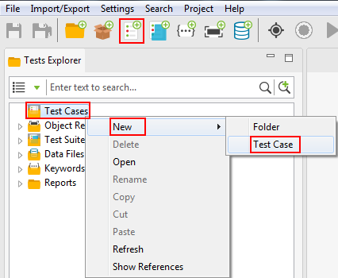
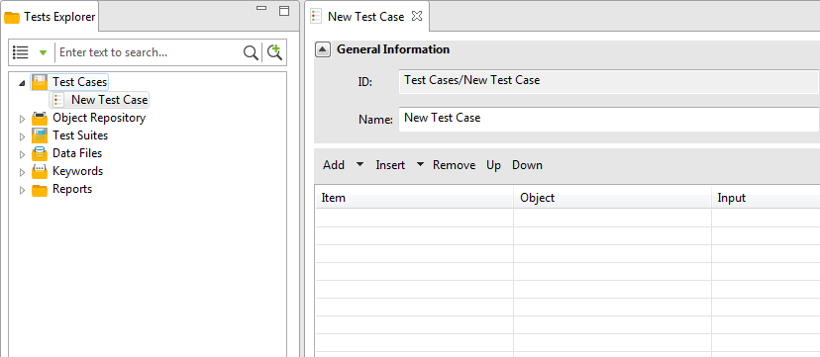
Create test case
Click New Test Case button on Toolbar
Right click on Test Cases folder > New > Test Case
katalon studio tutorial

Slide 14
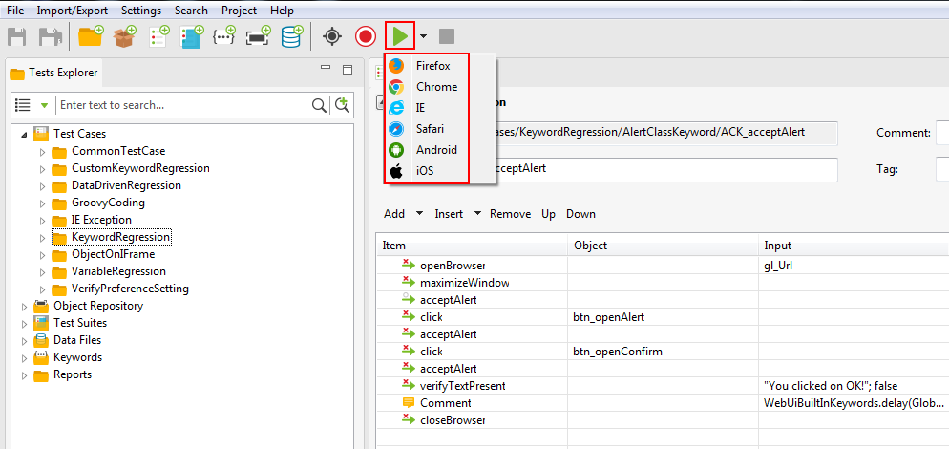
RUN test case
Click Run button to run test case with default browser (in Settings > Preferences > Execution)
Click arrow button, select a browser to run the test case
katalon studio tutorial

Slide 15
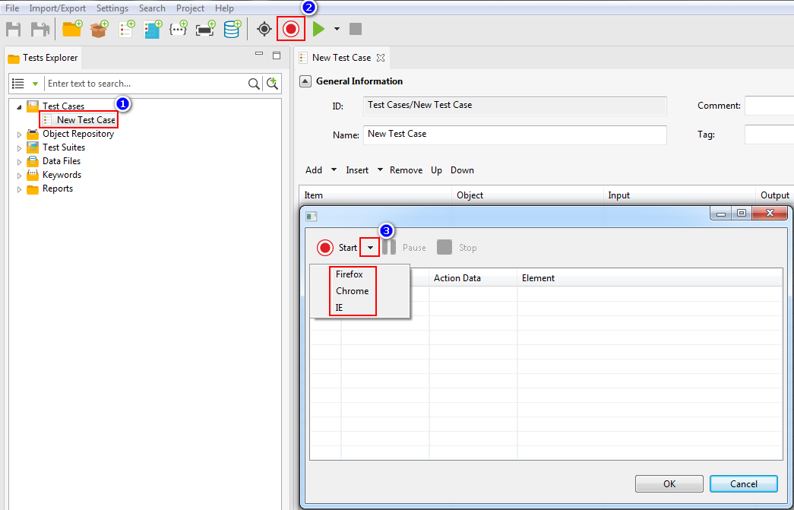
Record test case
Click Record button
Create a test case and select it
Click arrow button and select browser to start recording
katalon studio tutorial

Slide 16
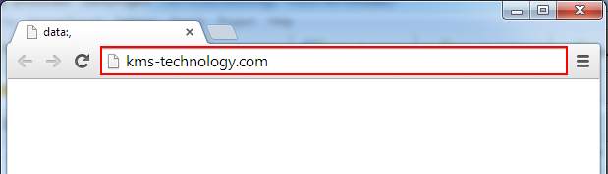
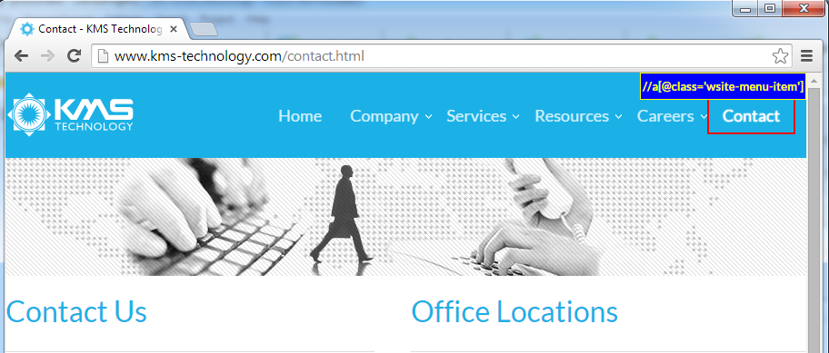
Record test case
Type url and press Enter to navigate to the website
System will record user’s actions
katalon studio tutorial

Slide 17
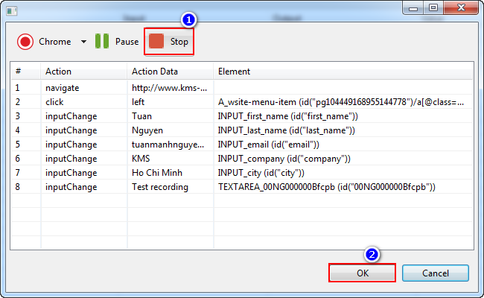
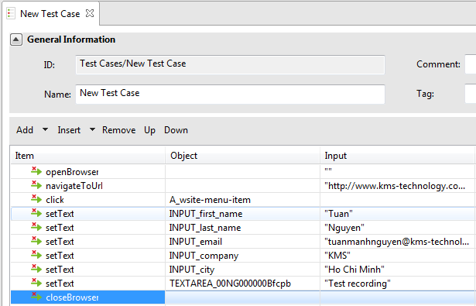
Record test case
Click Stop button to end recording
Click OK to save recorded steps to test case
katalon studio tutorial

Slide 18
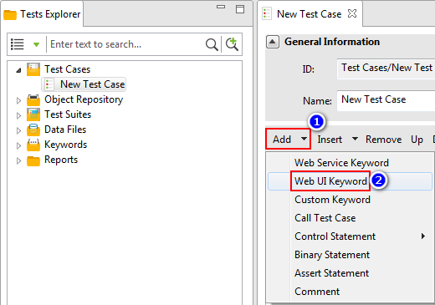
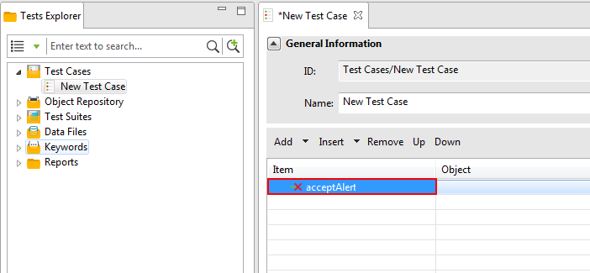
Scripting – keyword-driven
Click the arrow next to Add button
Select keyword category to add
A new test step is added into the test case
katalon studio tutorial

Slide 19
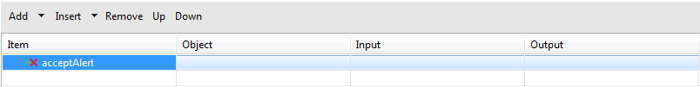
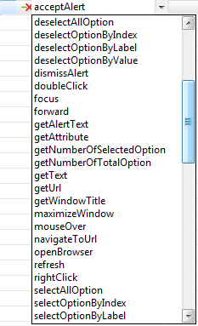
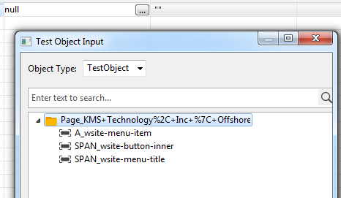
Scripting – keyword-driven
Select a keyword from the drop-down list
Select a test object if the keyword requires
katalon studio tutorial

Slide 20

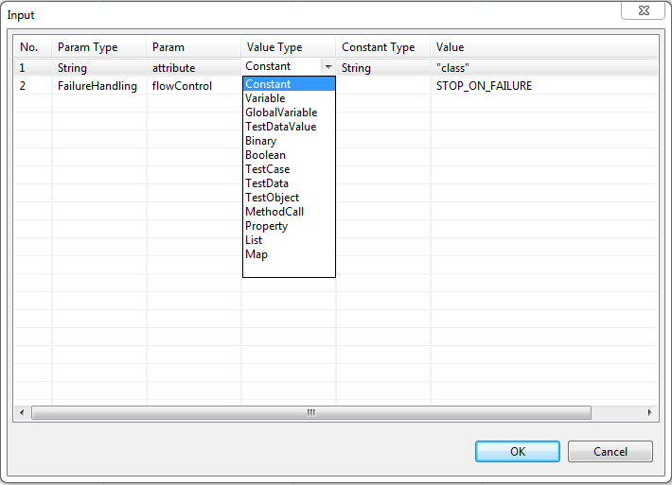
Scripting – keyword-driven
Click to enter input value for the keyword
Select Constant if input is hard-coded text or number
Enter variable to store value returned from keyword
Select Variable if input is variable
Select GlobalVariable if input is variable that is used to transfer data among test cases
katalon studio tutorial

Slide 21
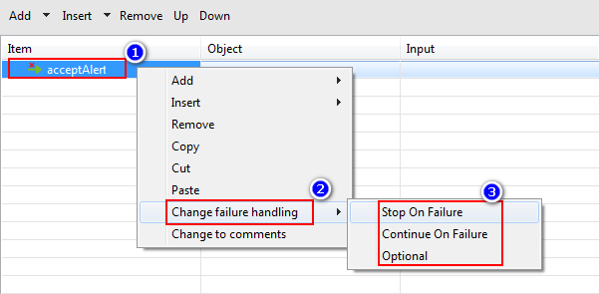
Scripting – Failure handling
Right click on step
Stop On Failure: when step fails, system stops test case. Step is marked as FAILED.
Select Change failure handling
Continue On Failure: when step fails, system continues test case. Step is marked as FAILED.
Optional: when step fails, system continues test case. Step is marked as WARNING.
katalon studio tutorial

Slide 22
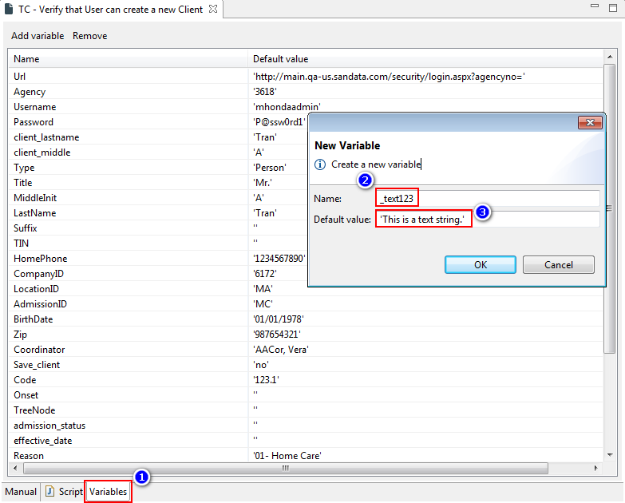
Variable
Variables tab are used to expose arguments of the test case when it is called by other test cases or test suites
Variable name follows Groovy rules: only contain underscore ( _ ), letter and digit
Default value is enclosed by single quote ( ‘ ) if it is text string
Click Variables tab
katalon studio tutorial

Slide 23
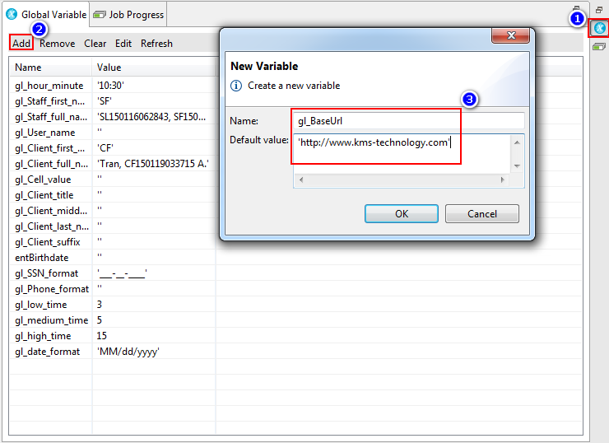
Global variable
Click to open Global Variable pane
Users can define global variables to pass values among call test cases or test cases in test suite
Click to add new global variable
Enter name and default value for global variable
katalon studio tutorial

Slide 24
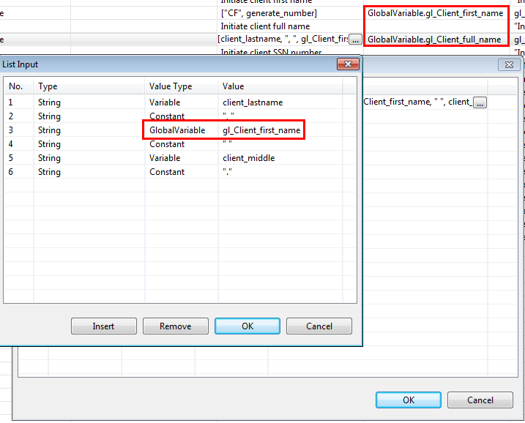
Global variable
To use global variable in Output, enter GlobalVariable.<name of the global variable>
To use global variable in Input, select GlobalVariable for Value Type
katalon studio tutorial

Slide 25
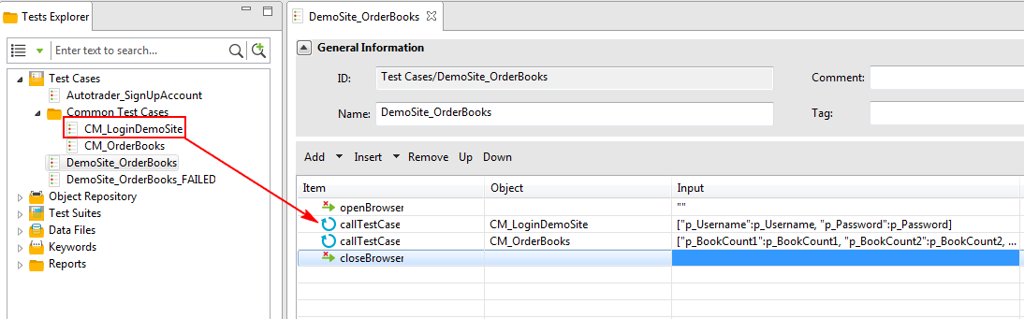
Call Test Case
There are some steps used repeatedly in many test cases. We should separate them into common test cases.
Users can drag a common test case and drop it to another test case to call (reuse)
katalon studio tutorial

Slide 26
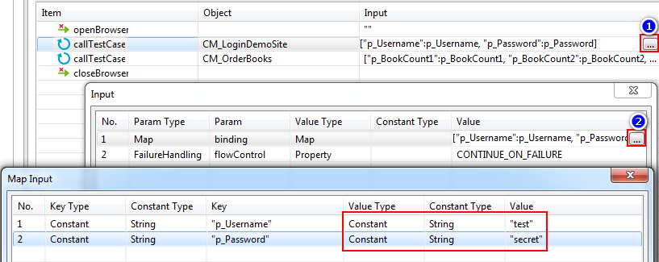
Call test case
Click to open Input pane for the called test case
Click to open Map Input pane
Map hard-coded values to called test case’s arguments
Map variables to called test case’s arguments
Map global variables to called test case’s arguments
katalon studio tutorial

Slide 27
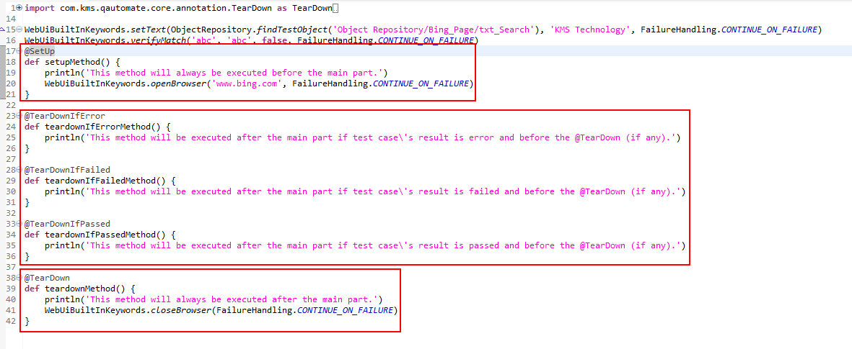
Setup and teardown method
Method following @Setup will be executed first
Method following @TearDownIf… will be executed after the main part and before @TearDown (if any)
Method following @TearDown will be executed last
katalon studio tutorial

Slide 28
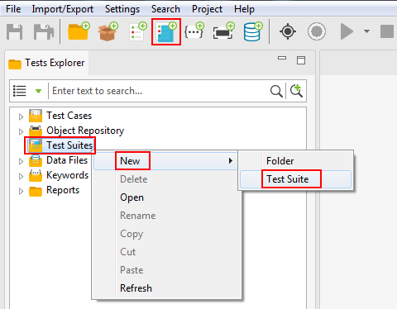
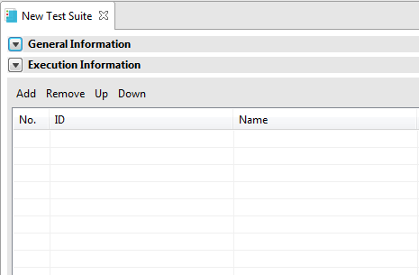
Create test suite
Click New Test Suite button on Toolbar
Right click on Test Suites folder > New > Test Suite
katalon studio tutorial

Slide 29
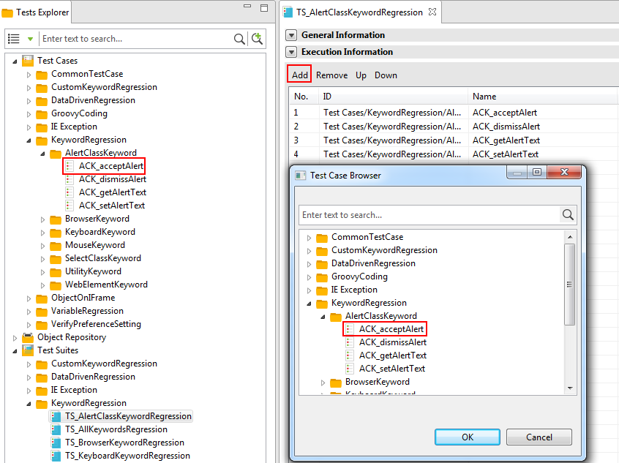
Create test suite
Click Add button and select test case to add into test suite
Drag and drop test case to test suite
katalon studio tutorial

Slide 30
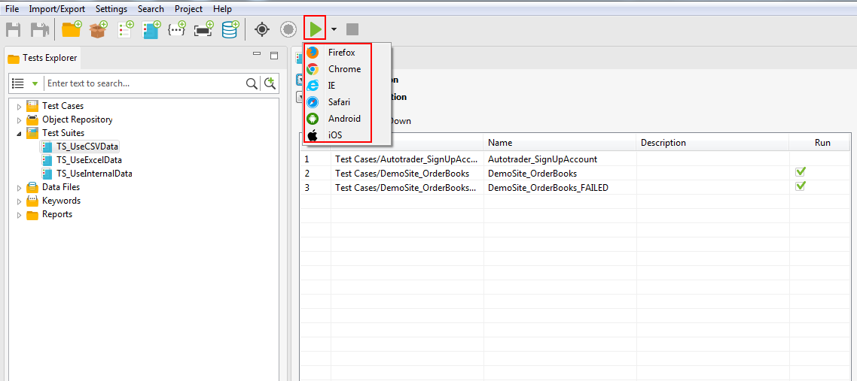
Run test Suite
Click Run button to run test suite with default browser (in Settings > Preferences > Execution)
Click arrow button, select a browser to run the test suite
katalon studio tutorial

Slide 31
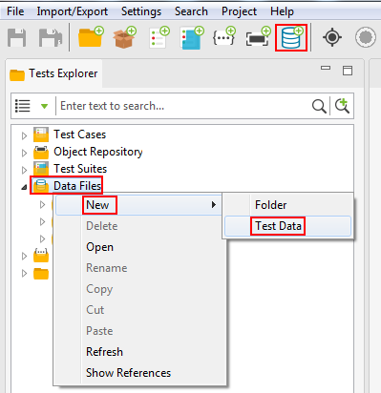
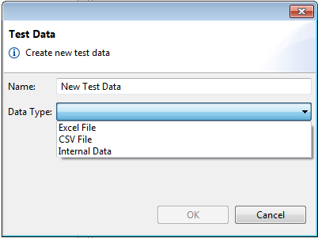
Create test data
Click New Test Data button on Toolbar
Users can import data from Excel file, CSV file or use internal data (table)
Right click on Data Files folder > New > Test Data
katalon studio tutorial

Slide 32
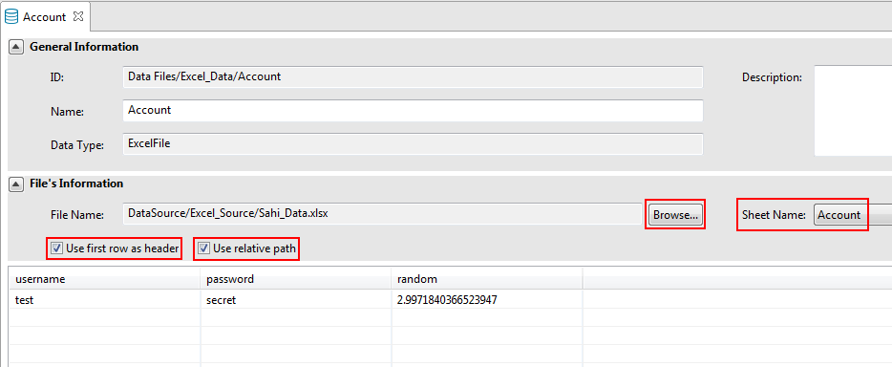
Excel file data
Data source from Excel file
Check if first row of Excel file is header
Check if use relative path
Click to select Excel file
Select sheet in Excel file
katalon studio tutorial

Slide 33
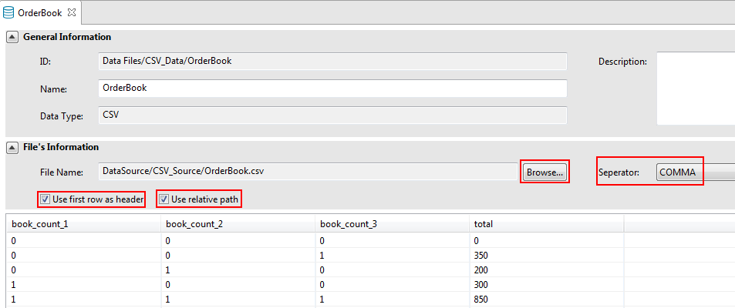
CSV FIle data
Data source from CSV file
Check if first row of CSV file is header
Check if use relative path
Click to select CSV file
Select separator
katalon studio tutorial

Slide 34
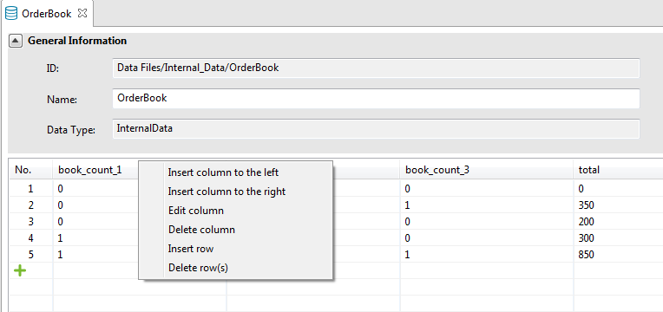
Internal data
Internal data
Right click to add column, row
katalon studio tutorial

Slide 35
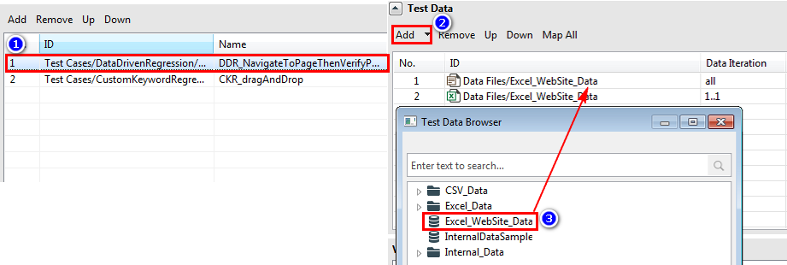
Use test data
Click Add button
Focus on test case
Users can assign multiple test data for one test case
Select test data
katalon studio tutorial

Slide 36
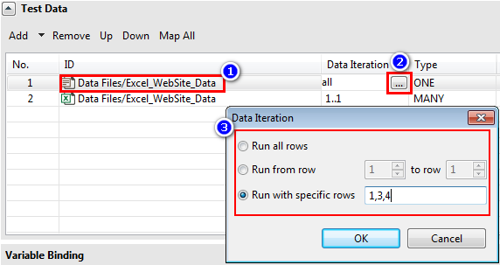
Use test data
Select test data
Click Data Iteration button
Specify which data rows are used. Row index starts from 1.
katalon studio tutorial

Slide 37
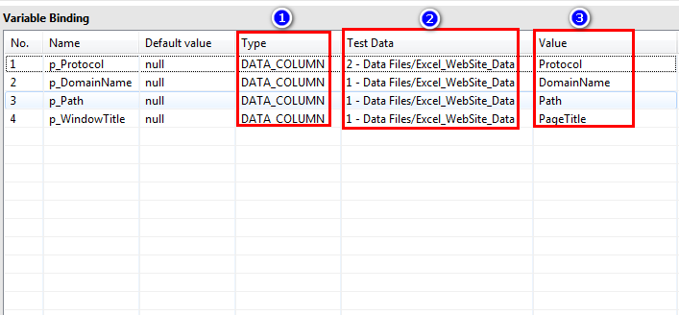
Use test data
Select DATA_COLUMN for Type
Select test data
Select column name
katalon studio tutorial

Slide 38
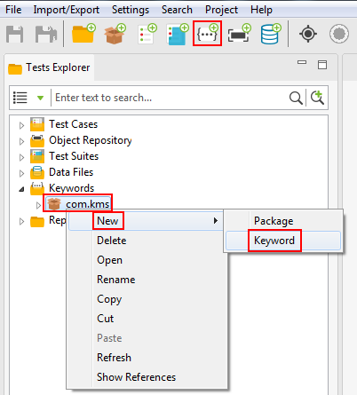
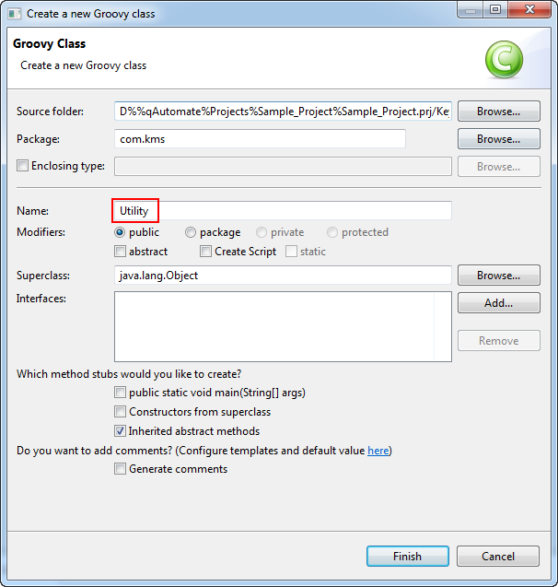
Create custom keyword
Click New Keyword button on Toolbar
Enter name for the class
Right click on a package > New > Keyword
katalon studio tutorial

Slide 39
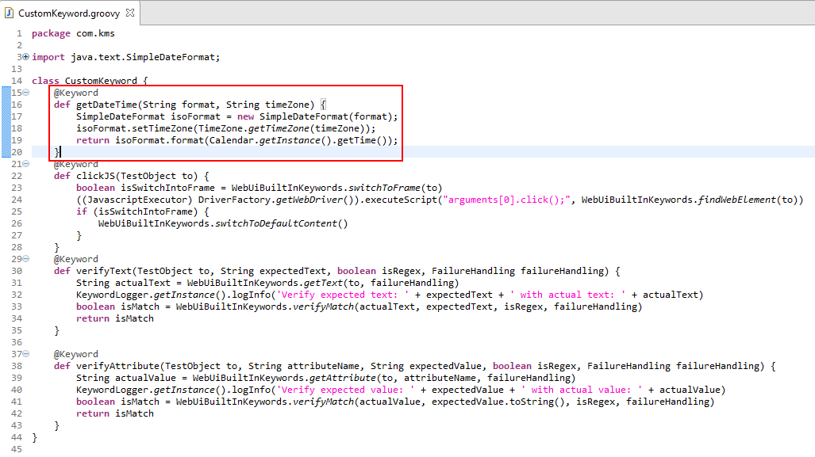
Create custom keyword
Follow template
@Keyword
def … {
}
to create a custom keyword
katalon studio tutorial

Slide 40
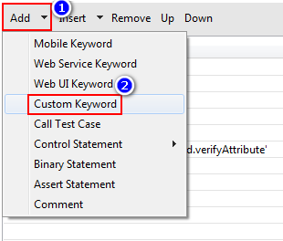
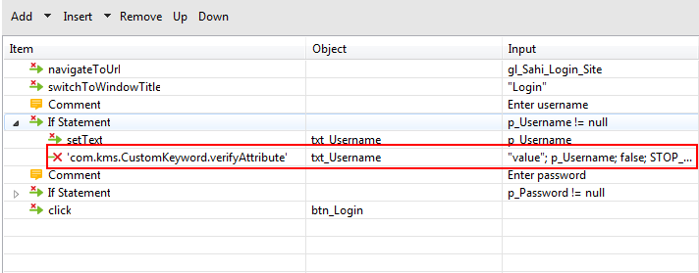
Use custom keyword
Click the arrow next to Add button
Select Custom Keyword to add
katalon studio tutorial

Slide 41
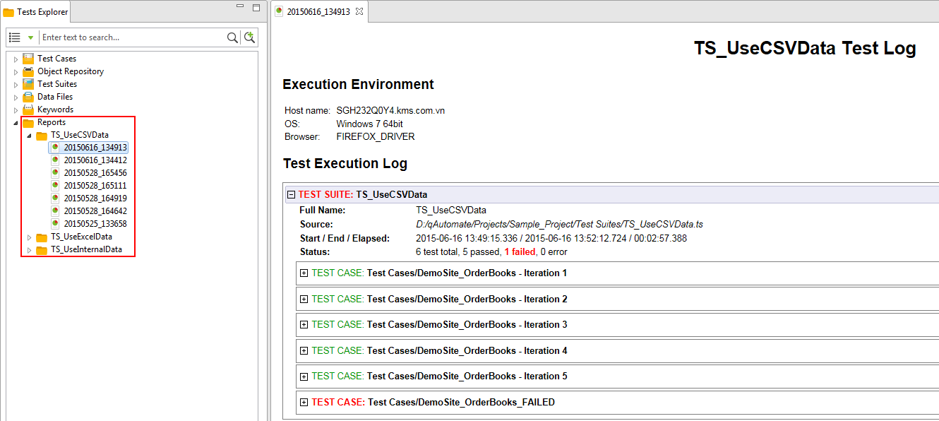
Test Suite Report
Test suite report will be stored in Reports folder
katalon studio tutorial

Slide 42
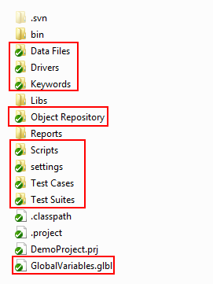
Source control - svn
Commit these files and folders to SVN
katalon studio tutorial

Slide 43
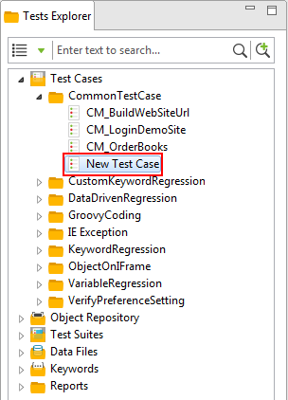

Source control - svn
Remember to commit test case with its Groovy script file
katalon studio tutorial

Slide 44


Console mode run
Configure SMTP if not use this one
Open Preferences dialog
Enter recipient emails to receive summary report. Emails are semi-colon separated.
katalon studio tutorial

Slide 45


Console mode run
Open command prompt (cmd) and navigate to folder containing katalon.exe file
Enter command to run test suite in console mode
katalon studio tutorial

Slide 46
Console mode run
Use command katalon with those options to run test suite in console mode:
-runMode=console : enable console mode (mandatory)
-consoleLog : display console (optional)
-noExit : keep console after run completed (optional)
-summaryReport : send summary report for a batch run (optional)
-statusDelay=<seconds> : system will update execution status of the test suite after those seconds (optional)
-reportFileName=<name> : specify name for report files (.html, .csv, .log); if don't specify, system uses name "report" (report.html, report.csv, report.log). This option only affects when using with -reportFolder option (optional)
-projectPk=<project file absolute path> : project location (include .prj file) (mandatory)
-execute : indicate system will execute the following test suite (mandatory)
-testSuiteID=<test suite file relative path> : test suite file (without extension .ts) (mandatory)
-browserType=<Firefox;Chrome;IE;Safari> : specify one browser type (mandatory)
-reportFolder=<folder path> : specify folder to save report files. Can use absolute path or relative path (root being project folder) (optional)
katalon studio tutorial

Slide 47
Console mode run
Example:
Use default report folder and report name
katalon -runMode=console -summaryReport -projectPk="D:\qAutomate_RCP\VerifyBuild\Project\RegressionTest\RegressionTest.prj" -execute -testSuiteID="Test Suites\DataDrivenRegression\TS_DataDrivenRegression" -browserType=Firefox
Specify report folder using absolute path, NOT specify report name (system use name "report" for report files of all test suites)
katalon -runMode=console -summaryReport -projectPk="D:\qAutomate_RCP\VerifyBuild\Project\RegressionTest\RegressionTest.prj" -execute -testSuiteID="Test Suites\DataDrivenRegression\TS_DataDrivenRegression" -browserType=Firefox -reportFolder="D:\Report_Folder\FirefoxRun"
Specify report folder using relative path, specify report name (system uses this name for report files of all test suites)
katalon -runMode=console -summaryReport -reportFileName="index" -projectPk="D:\qAutomate_RCP\VerifyBuild\Project\RegressionTest\RegressionTest.prj" -execute -testSuiteID="Test Suites\DataDrivenRegression\TS_DataDrivenRegression" -browserType=Firefox -reportFolder="Reports\KeywordRegression\TS_AlertClassKeywordRegression\FirefoxRun"
katalon studio tutorial

Slide 48


qTest integration – setup
Select Project Settings
Enter information to generate authentication token
katalon studio tutorial

Slide 49


qTest integration – setup
Update and select qTest project to integrate
katalon studio tutorial

Slide 50

qTest integration – setup
Enable Auto-submit test run result
Select when to send attachment
katalon studio tutorial

Slide 51


qTest integration – upload test case
Right click on folder/test case > qTest > Upload
Test cases will be uploaded to qTest Test Design
katalon studio tutorial

Slide 52

qTest integration – upload test suite
Open test suite > select Integration tab > select parent
katalon studio tutorial

Slide 53



qTest integration – upload test suite
Upload test suite to qTest
Set parent as default
Test suite will be uploaded to qTest Test Execution
katalon studio tutorial

Slide 54


qTest integration – Send test case result
Run test suite
Test case result will be sent to qTest Test Execution
katalon studio tutorial

Slide 55


qTest integration – disintegrate test suite
Disintegrate test suite
Katalon will delete connecting information. Test suite is still kept on qTest Test Execution
katalon studio tutorial

Slide 56

qTest integration – disintegrate test case
Disintegrate test case
Katalon will delete connecting information. Test cases are still kept on qTest Test Design
katalon studio tutorial

Slide 57

WEB SERVICE TEST – CREATE NEW REQUEST
In order to use WS keyword to run API test, we need to pass them a request

Slide 58

WEB SERVICE TEST – CREATE NEW REQUEST
Select which type of request you want to create based on your type of API test

Slide 59

WEB SERVICE TEST – MODIFY REST REQUEST
After a request is created , you need to input more information to the request to make it workable later for sending this request
Picture below is an example of how we should input based on this request:
http://api-beta.breezometer.com/baqi/?lat=40.7324296&lon=-73.9977264&key=your-key

Slide 60

WEB SERVICE TEST – MODIFY SOAP REQUEST
Based on existing SOAP request, we can map them into corresponding fields like below

Slide 61

WEB SERVICE TEST – RUN TEST CASE
These are the final steps to run your API test with created request from step 2.
Each API test should be considered as an normal test case in Katalon
For API test case, we should use “Web Service Keyword” by adding it from the list

Slide 62


WEB SERVICE TEST – RUN TEST CASE
To send a request with our created request, we need to select “sendRequest” keyword, with the input is our created request
To verify response messages from a request, we can select other “verify” actions based on your purposes

